Slide 1
Multiple Hypothesis Testing
The problem
Controlling the error rate
Correction methods

Slide 2
Rhine Paradox
Joseph Rhine was a parapsychologist in the 1950’s (founder of the Journal of Parapsychology and the Parapsychological Society, an affiliate of the AAAS).
He ran an experiment where subjects had to guess whether 10 hidden cards were red or blue.
He found that about 1 person in 1000 had ESP, i.e. they could guess the color of all 10 cards.

Slide 3
Rhine Paradox (cont’d)
He called back the “psychic” subjects and had them do the same test again. They all failed.
He concluded that the act of telling psychics that they have psychic abilities causes them to lose it…(!)
a great example of how not to conduct scientific research.

Slide 4
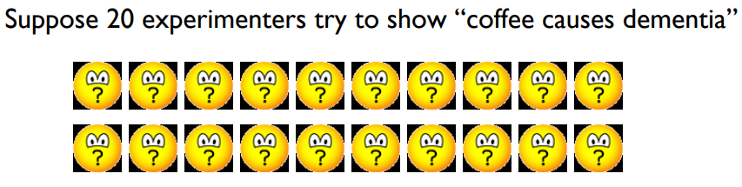
Significance and Publication Bias
Most scientific tests are probabilistic (due to measurement error, sampling etc), and are only true to some “significance” value, which is the false positive rate, e.g. 0.05
Both experimenters and journals have a strong bias to publish only results that “succeed”, i.e. which were significant at 0.05

Slide 5
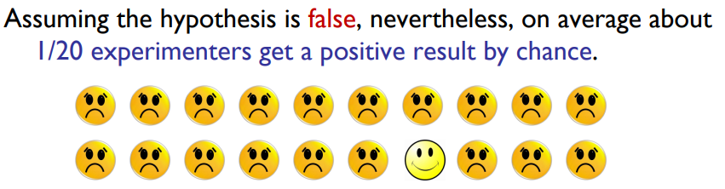
Significance and Publication Bias
The other 19 experimenters will probably never submit their results, nor the fact that they tried the experiment. If they did, unless there were other results in the paper, most journals would not publish it.
The one lucky experimenter will certainly want to publish and will probably succeed.
The research community concludes the hypothesis holds.

Slide 6
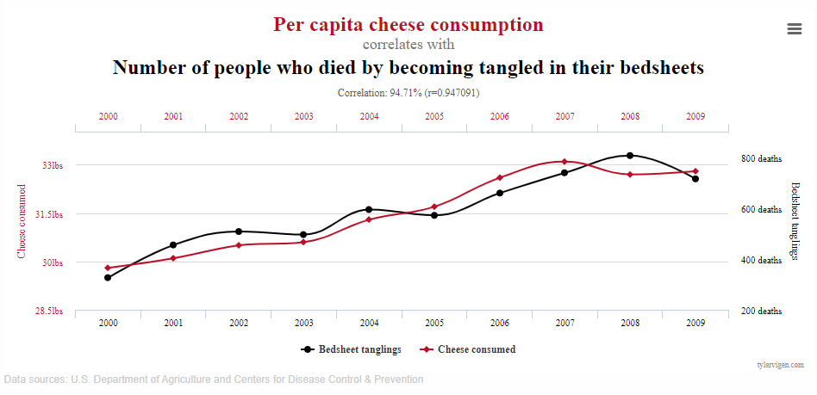
Spurious Correlations
Correlation: 0.947091

Slide 7
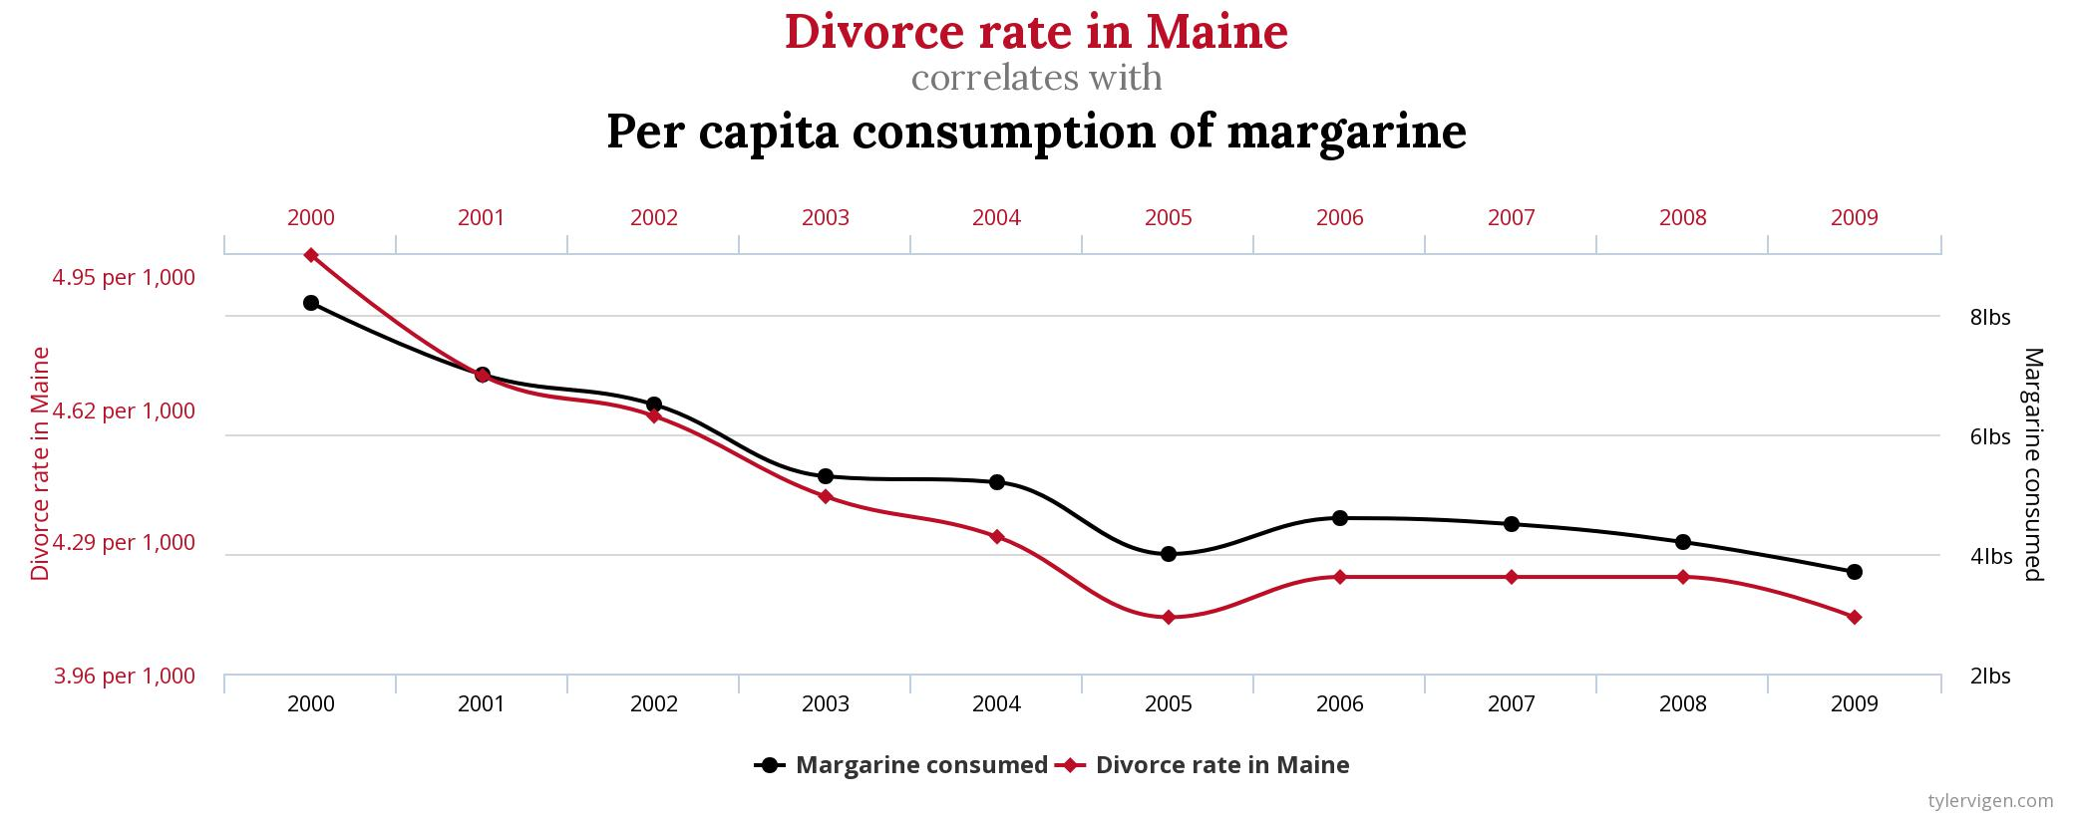
Spurious Correlations
Correlation: 0.992558

Slide 8
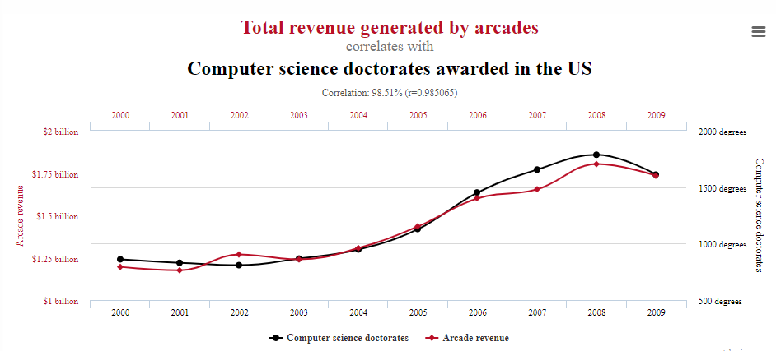
Spurious Correlations
Correlation: 0.98

Slide 9
Errors
Type I: False Positive. Experimenter rejects the null hypothesis (supports the original hypothesis) when it is not true, i.e. when the null hypothesis actually holds.
These are the most serious because results that are not true become part of the scientific record.
Type II: False Negative. Experimenter does not reject the null hypothesis even though it does not hold.
Arguable that this is an “error.” Provides no real evidence against the original hypothesis. Often the sample size was just too small. Minimal effect on the scientific record (may not get reported).

Slide 10
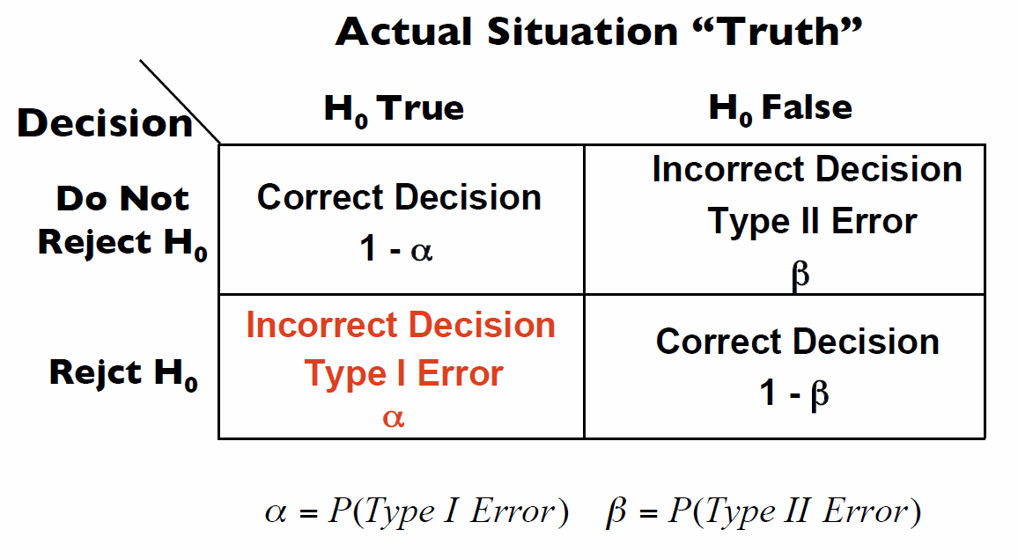
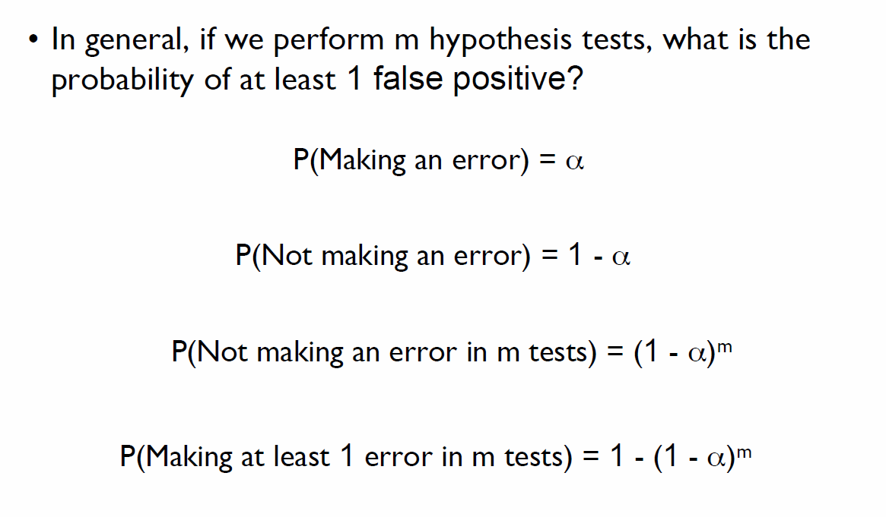
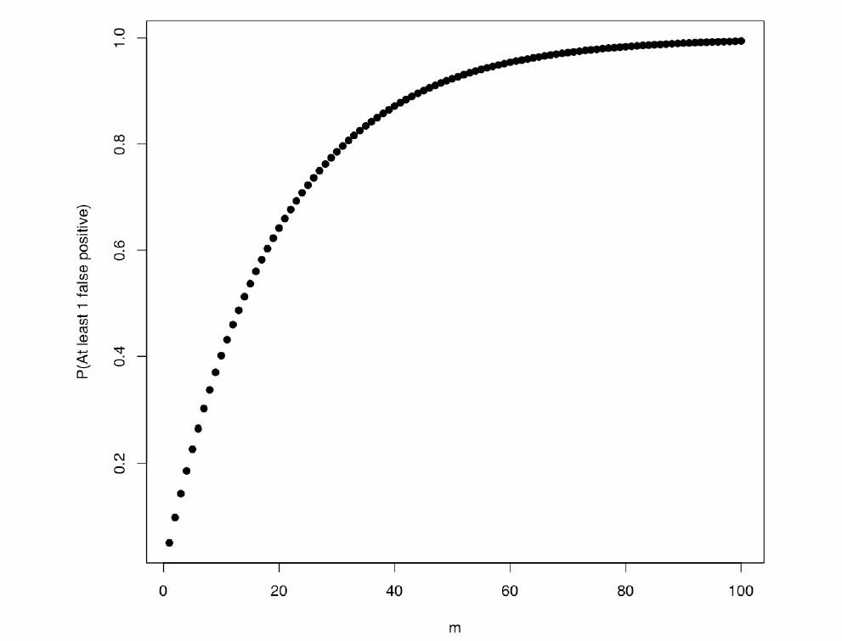
Multiple Hypothesis Testing
With three statistical tests: m = 3; P(at least one error) = 1 – (1-0.05)^3
= 0.143
14.3% chance to reject null hypothesis at least once as n error

Slide 11
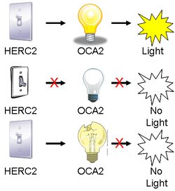
What are the hypotheses we are testing?
Comparing the distributions of each variable in two different samples for multiple variables
  Identifying differentially expressed genes in metastatic vs. non-metastatic cancer: 35K human genes => 35K hypotheses
Assessing pairwise associations between multiple variables
  Identifying epistatic pairs of genomic variants among 1M variants screened => 500B hypotheses

Slide 12
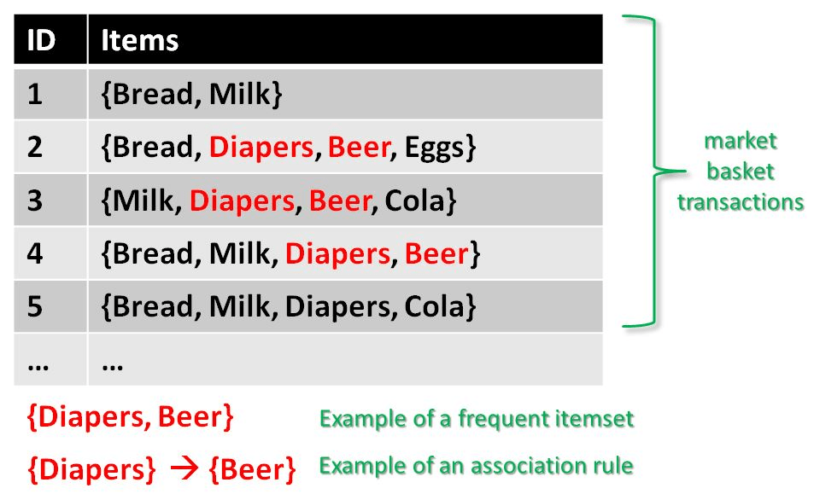
Combinatorial Space of Hypotheses
Need not be significant to be useful, but assessing significance can be informative
Identification of frequent itemsets
  Given n transactions each involving a subset of m items, find the sets of items that tend appear in transactions together
  Token problem of “data mining”
  If we are evaluating all possible subsets of items: 2^{m} hypotheses!

Slide 13
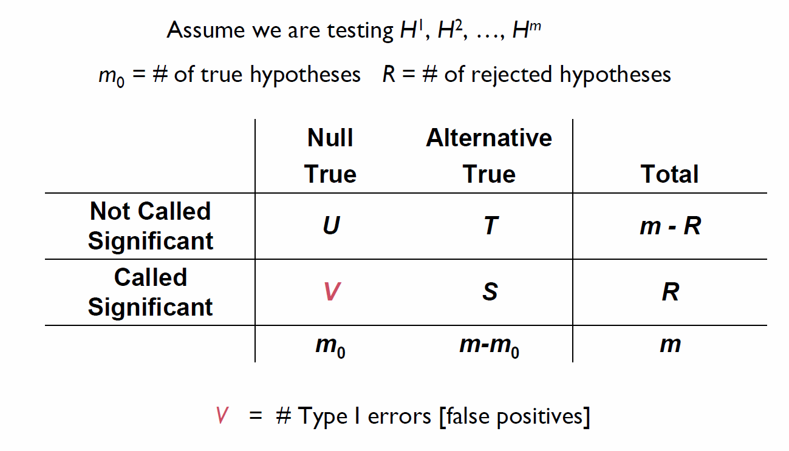
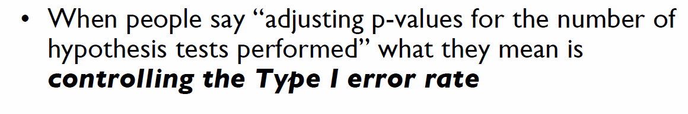
Counting The Errors

Slide 14
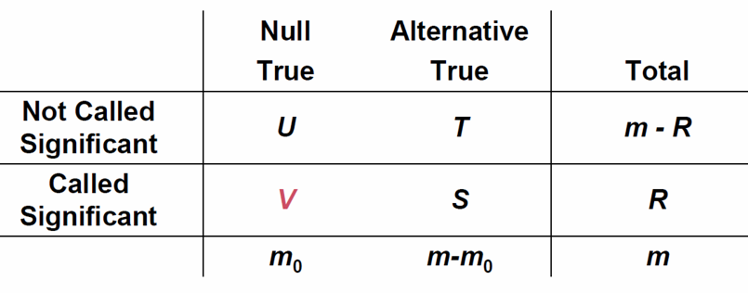
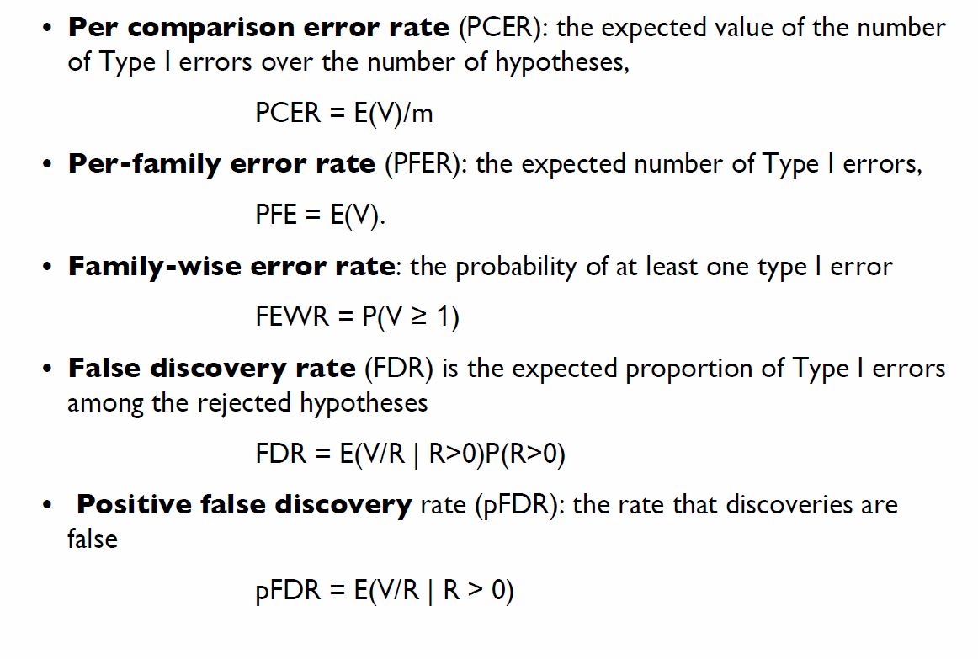
Controlling False Discoveries

Slide 15
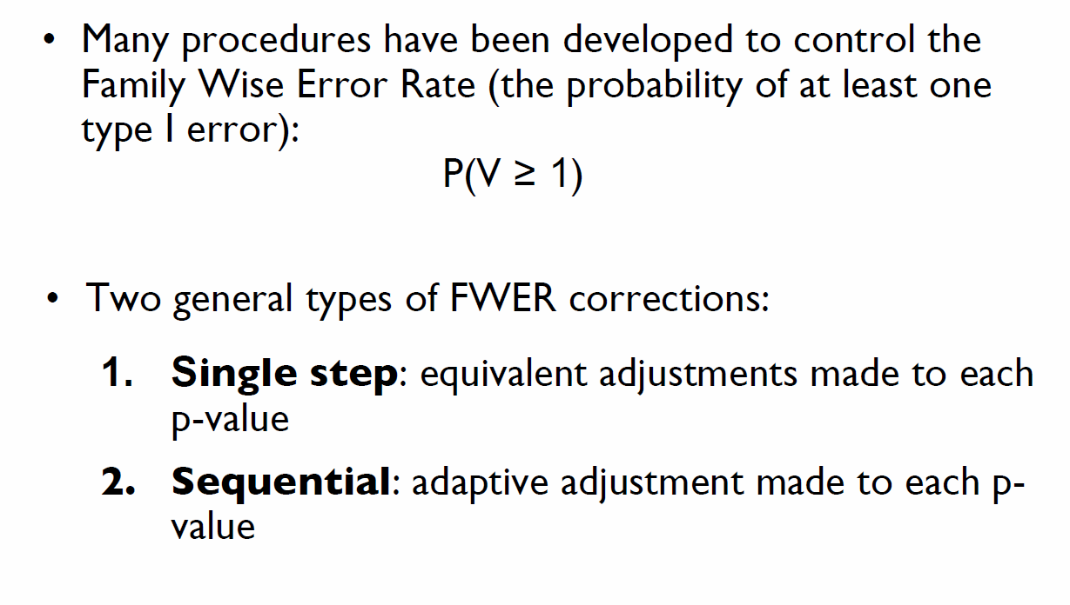
Family-Wise Error Rate (FWER)

Slide 16
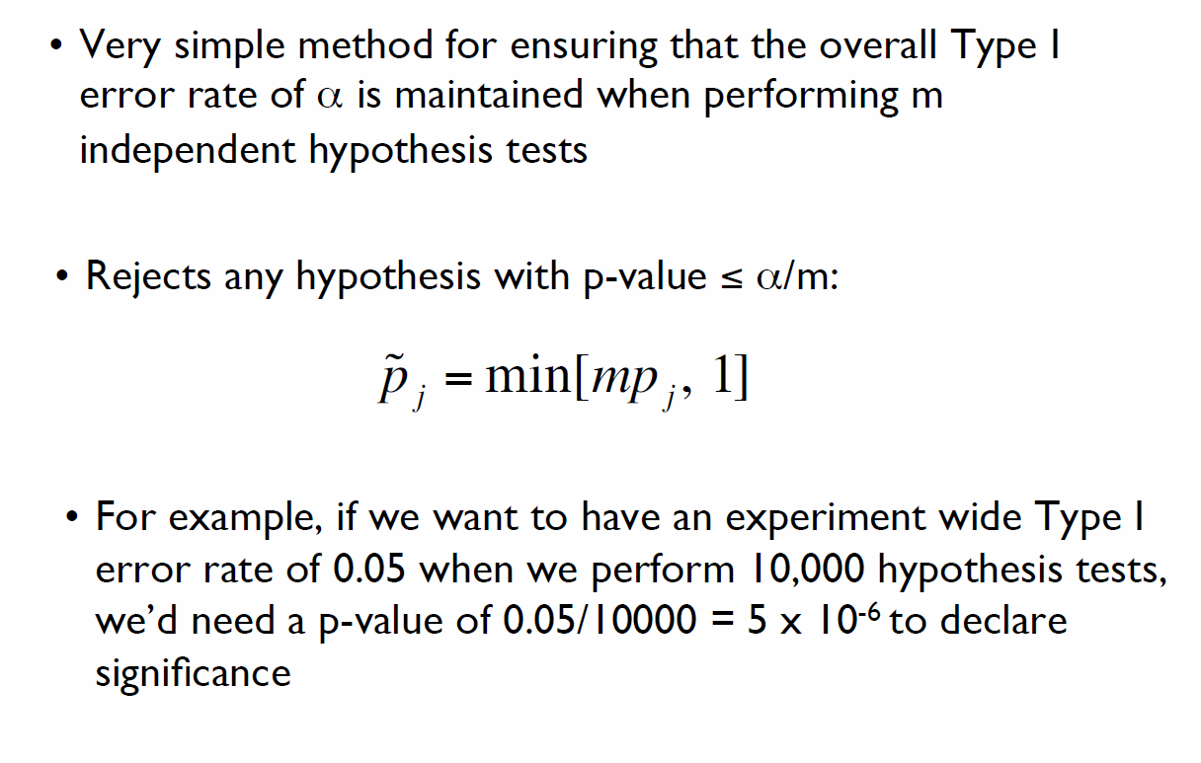
Bonferroni Correction
Idea: Correct p-values to reflect the probability of at least one false discovery by using union rule
With three statistical tests: m = 3;
P(at least one error) = 1 – (1-0.05)^3 = 0.143
Adjusted p-value = 0.05/3 = 0.017
p=0.019 , 0.048, 0.36
None are significant

Slide 17
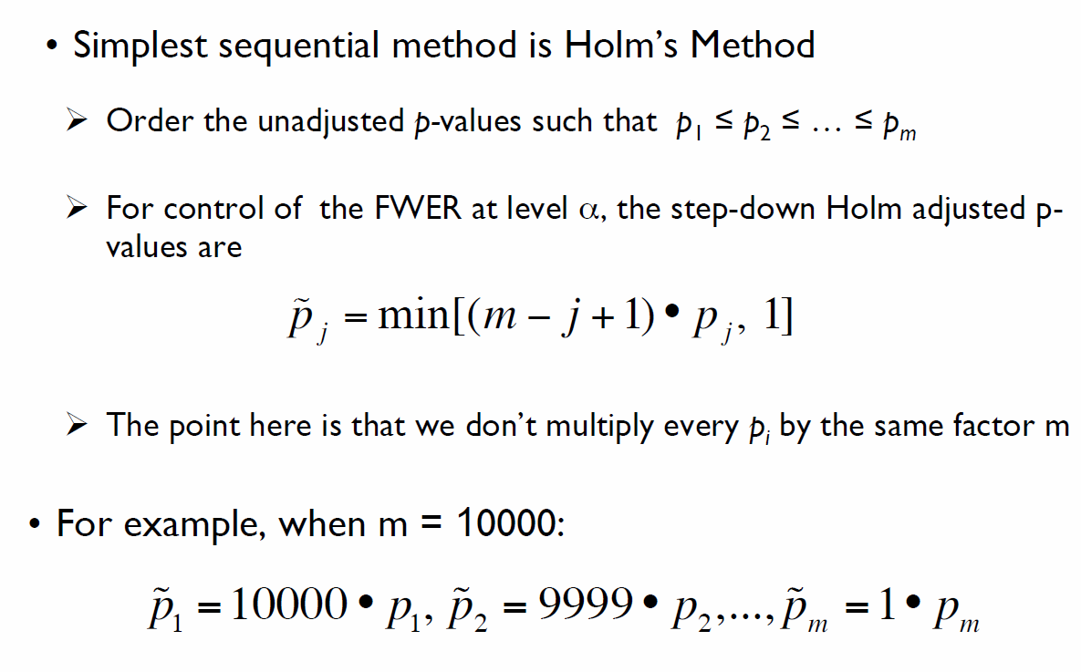
FWER: Sequential Adjustments

Slide 18
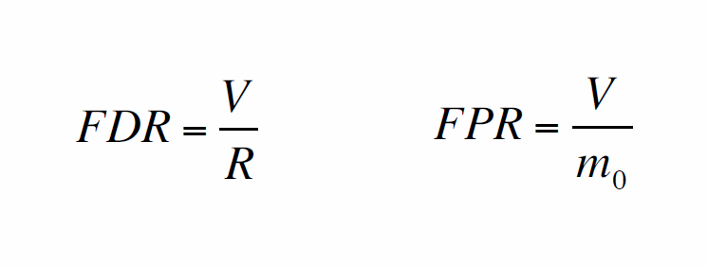
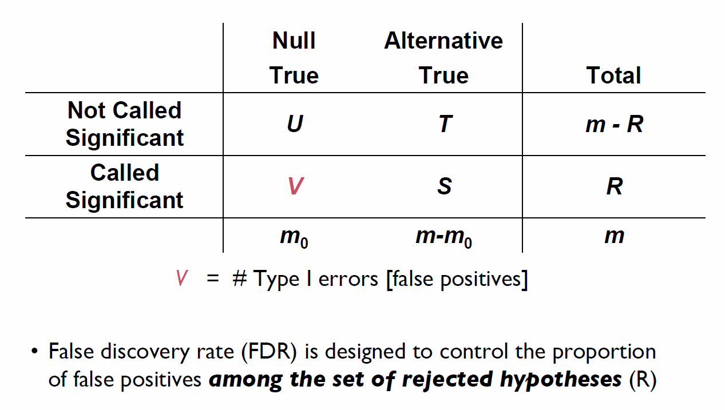
False Discovery Rate (FDR)
False Positive Rate

Slide 19
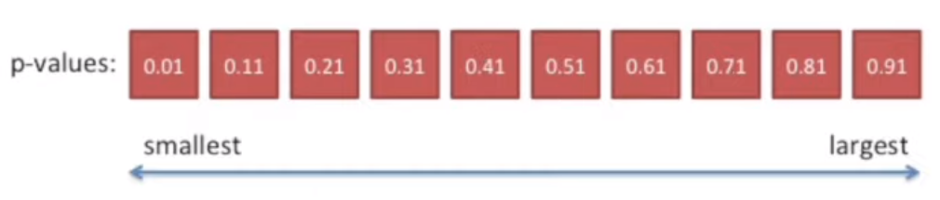
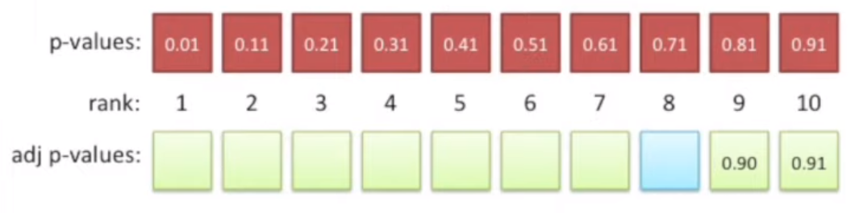
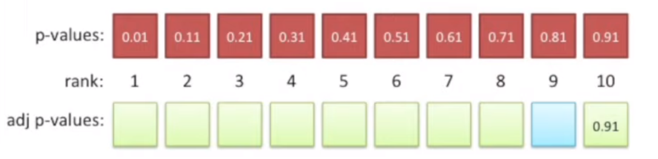
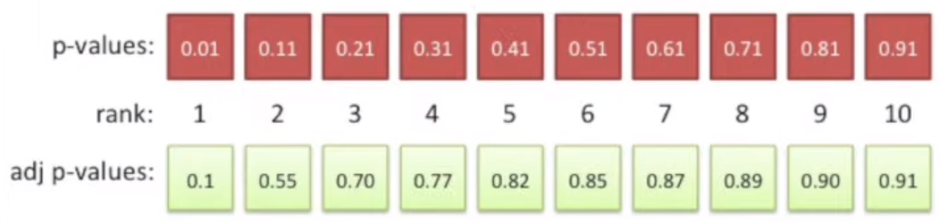
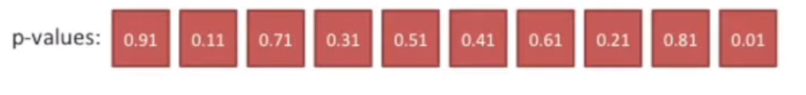
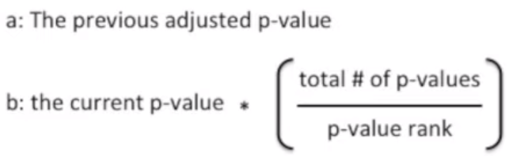
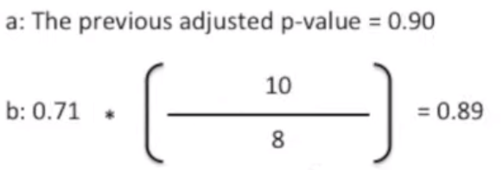
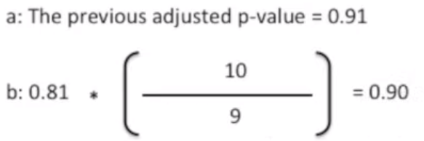
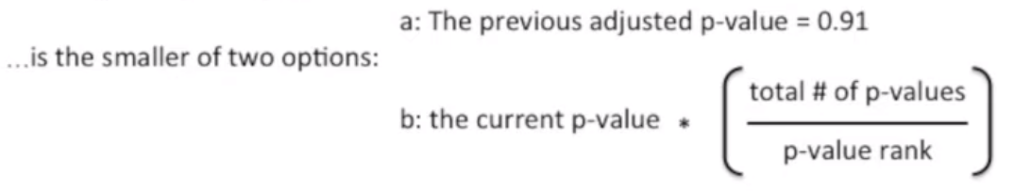
Benjamini and Hochberg Procedure
Suppose we have to reject all these hypothesis
0.90

Slide 20
Permutation Tests
Idea and Implementation

Slide 21
Permutation Tests
A type of non-parametric statistical significance test. It is used to determine whether two or more groups differ from each other to a degree that is unlikely to be due to chance.
Permutation tests offer a robust and flexible method for assessing statistical significance without relying heavily on the assumptions required by traditional parametric tests.

Slide 22
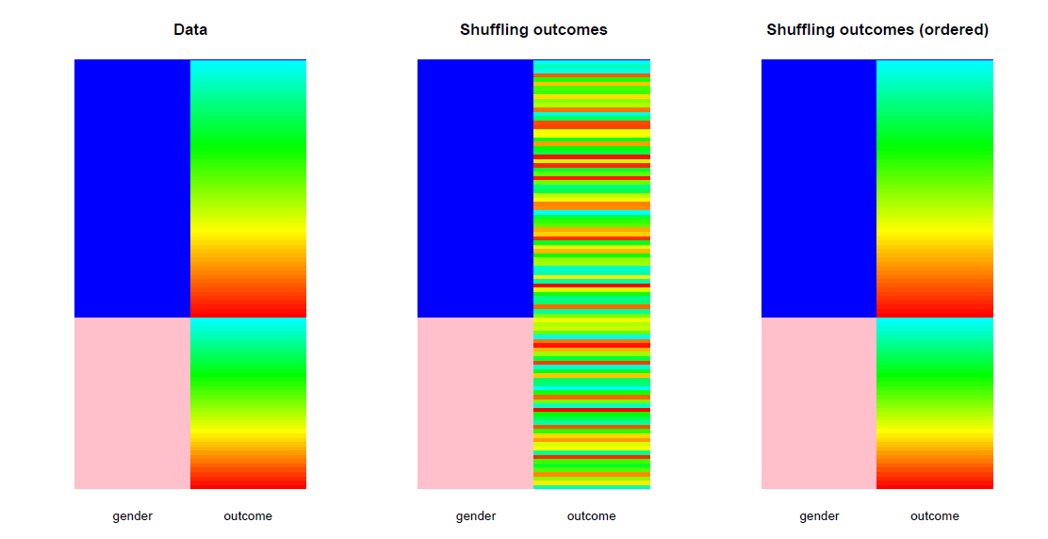
Is a certain outcome associated with gender or not?
High salary
High salary
Low salary
Low salary
High salary
High salary
Low salary
Low salary

Slide 23
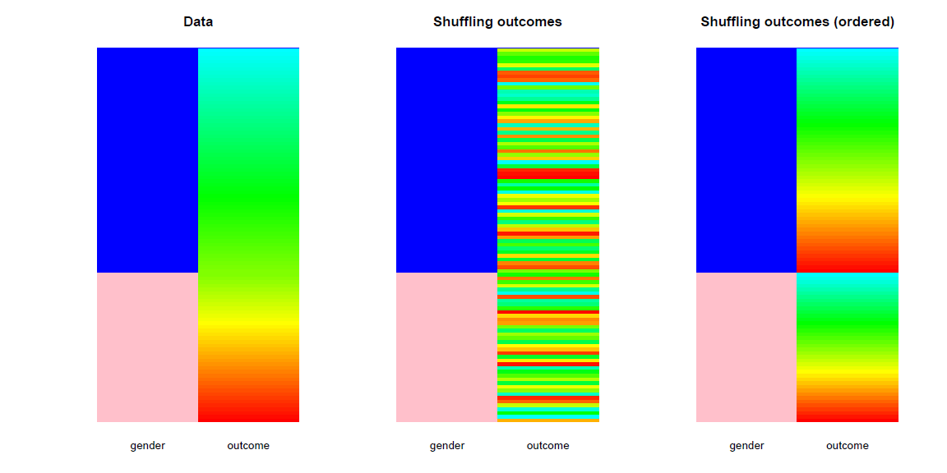
Is a certain outcome associated with gender or not?
High salary
High salary
Low salary
High salary
Low salary
Low salary

Slide 24
Permutation
To estimate the sampling distribution of the test statistic we need many samples generated under the strong null hypothesis.
If the null hypothesis is true, changing the exposure would have no effect on the outcome. By randomly shuffling the exposures we can make up as many data sets as we like.
If the null hypothesis is true the shuffled data sets should look like the real data, otherwise they should look different from the real data.
The ranking of the real test statistic among the shuffled test statistics gives a p-value

Slide 25
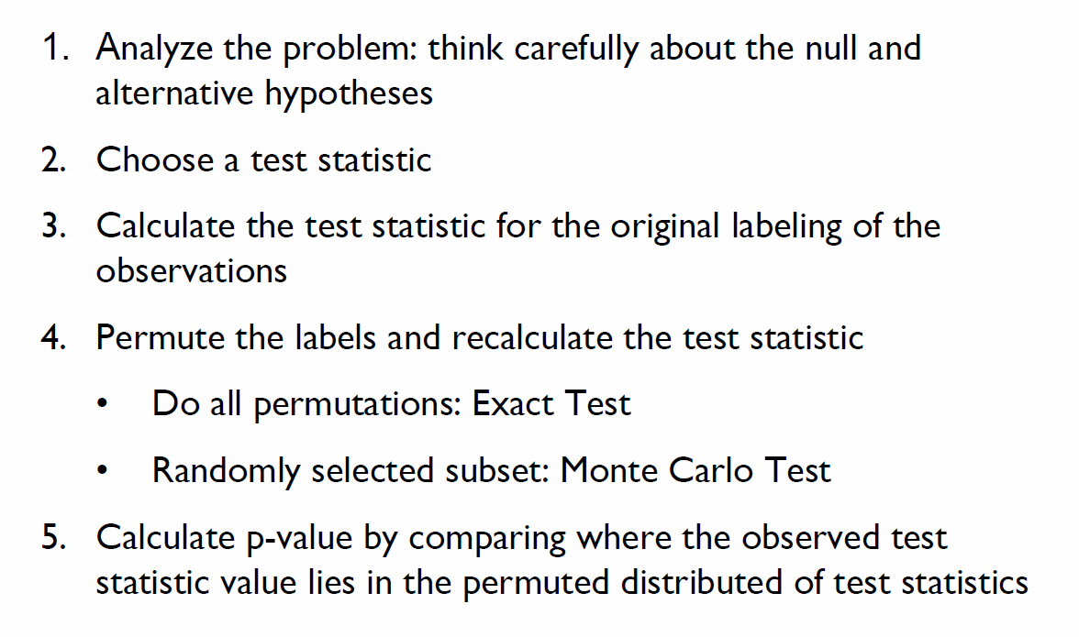
Permutation Tests: Framework
Conceptually define the null model
Figure out the permutation that corresponds to the null model
Generate and visualize the null distribution

Slide 26
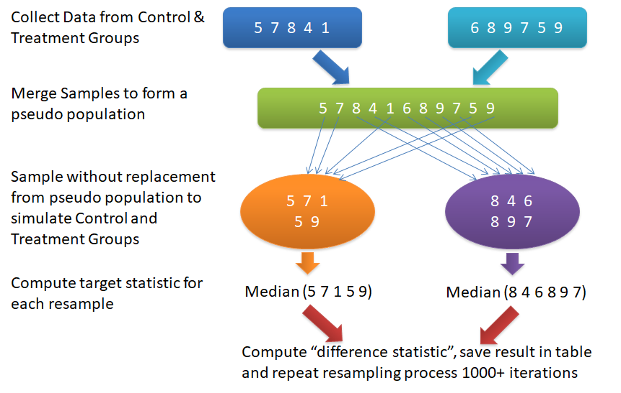
What is a Permutation Test?
A permutation test is a Monte-Carlo algorithm
Repeat multiple times to generate an empirical distribution
Mean
Mean

Slide 27
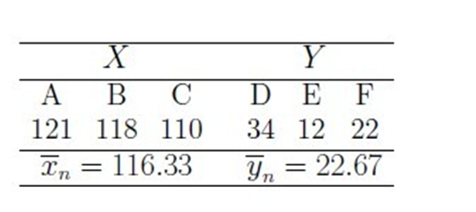

Permutation Test Example
Research Question: Does treatment with vitamin D enhance cell growth?
  6 petri dishes
    Control group: 3 containing standard medium (dishes D, E, and F)
    Treatment group: 3 containing standard medium + Vitamin D (dishes A, B, and C)
Measured outcome quantifies colonial growth
But the number of samples is too small for the t-test p-value to be reliable

Slide 28
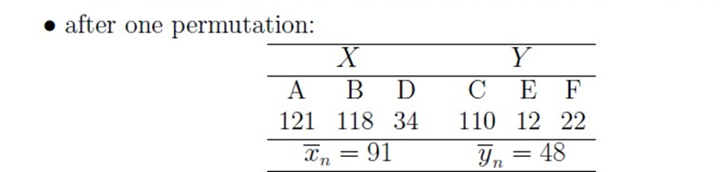

If We Permute the Classes
Assign dishes A, B, D to the control group
Assign dishes C, E, F to the treatment group
Can actually consider all possible permutations!
  Null model: The distribution of the 6 outcomes is given, the treatment group is selected uniformly at random

Slide 29
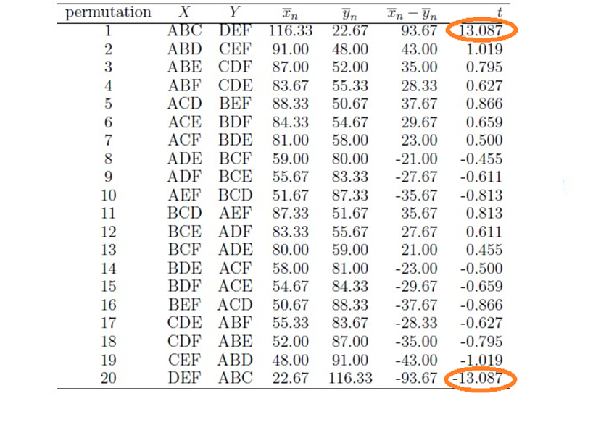
Considering All Permutations
p = 0.1

Slide 30
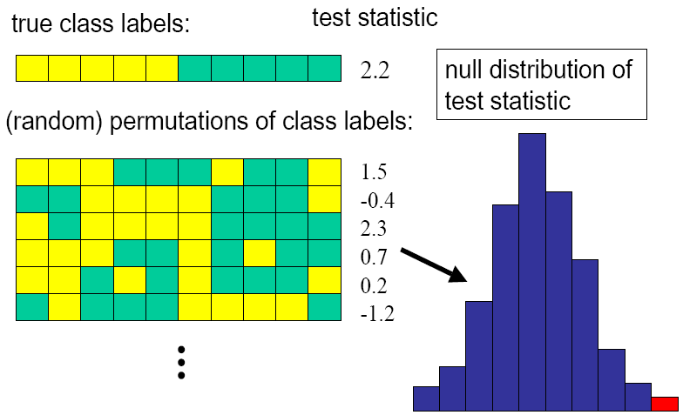
Monte-Carlo Algorithms for Permutation Testing
The number of possible permutations usually grows exponentially with the number of samples
  Generating all possible permutations not feasible for sufficiently large values of n
Use Monte-Carlo simulation to draw (uniformly at random) a large number (as permitted by computational resources and time) of permutations from the space of all possible permutations
  Use this sample to generate a null distribution for the test statistic

Slide 31
How many Permutation?
With 1000 permutations the smallest possible p-value is 0.001
A useful strategy is to start with 1000 permutations and continue to larger numbers only if p is small enough to be interesting, e.g. p < 0.1.

Slide 32
Advantages of Permutation Tests:
Flexibility: They can be used for a wide range of test statistics and experimental designs.
Fewer assumptions: They do not assume normal distributions or equal variances.
Exactness: For small sample sizes, permutation tests can provide exact p-values (given all possible permutations are considered).
Limitations:
Computationally intensive: They can require significant computational resources, especially for large datasets or complex statistics.

Slide 33
Multiple Hypothesis Testing via Permutation Testing
Assessing differential gene expression for multiple variables
  For each permutation, rank the test statistic across all variables
  Identify the “top” test statistic across all permutations
  The distribution of the “top” test statistic => Null hypothesis: There is no variable that can achieve that test statistic given the distribution of the values in the data matrix
  Can do this for other ranks as well

Slide 34
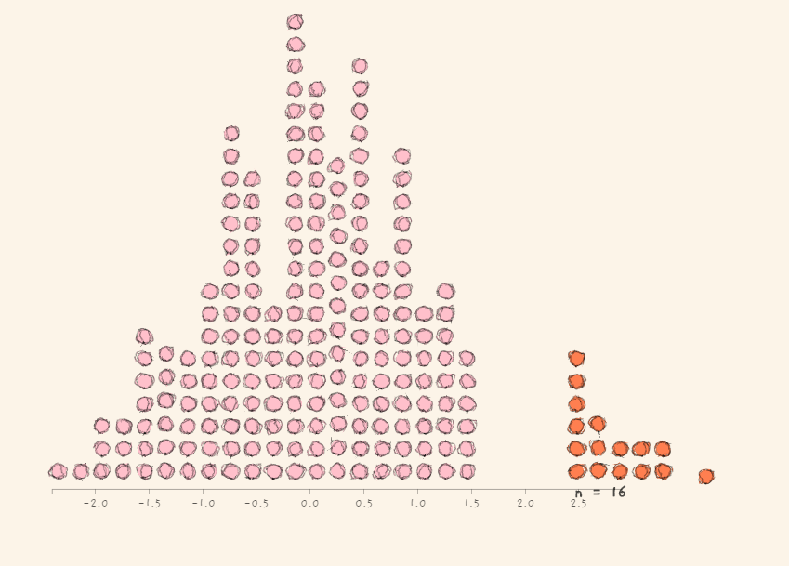
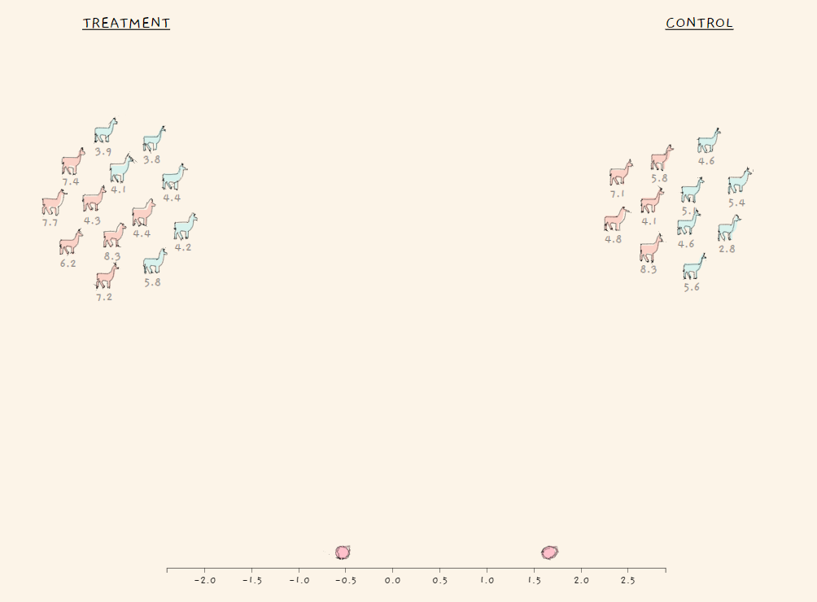
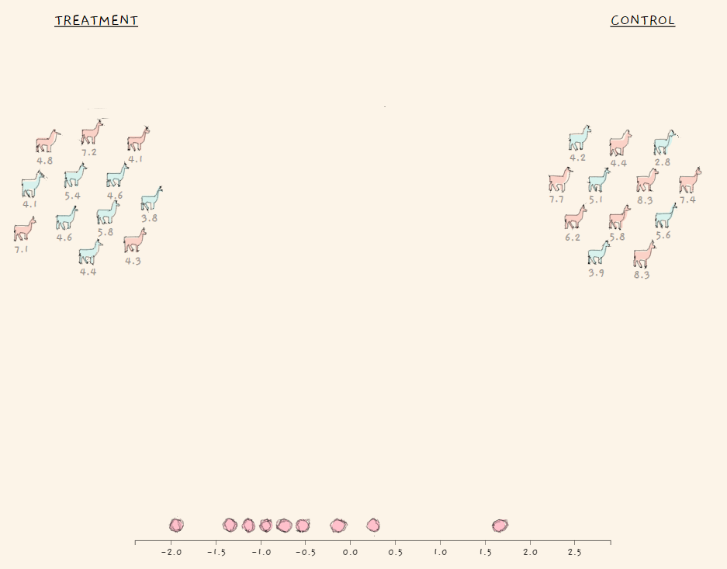
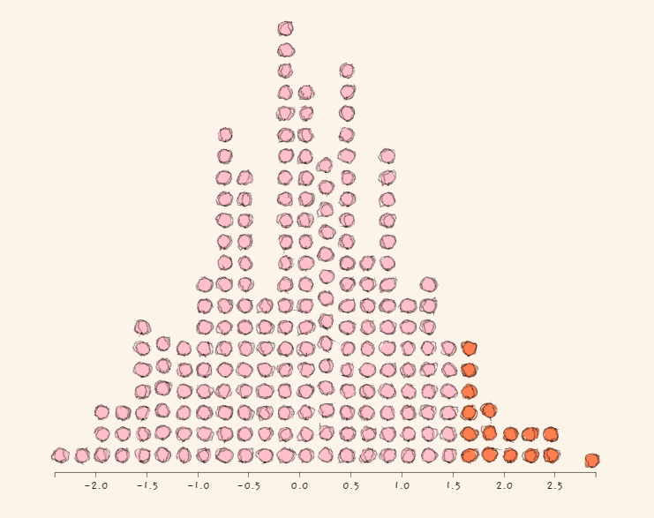
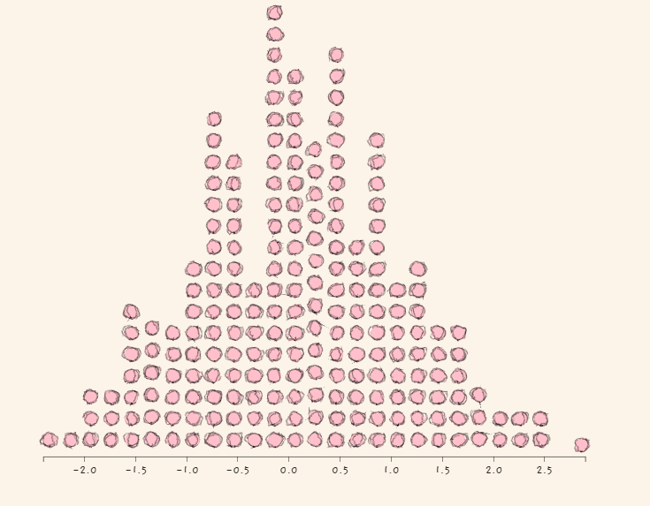
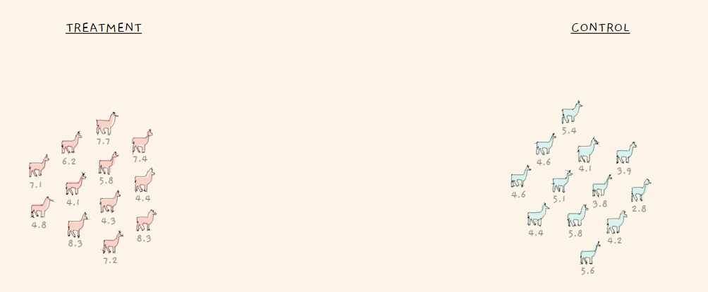

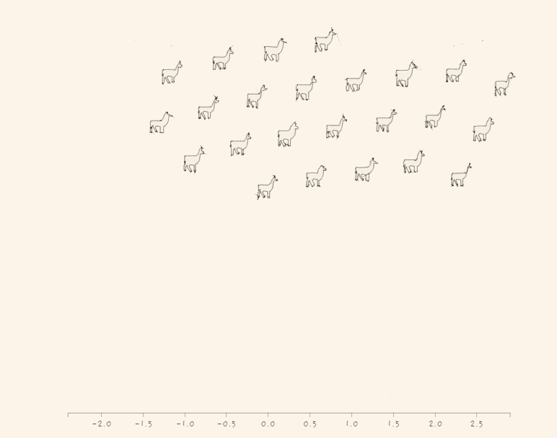
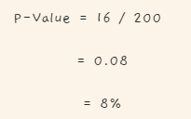
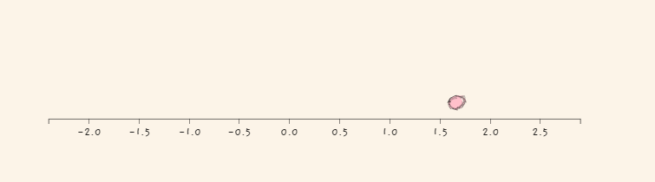
Another Example

Slide 35
Kahoot time

